Slide 1
Tabu Search for Portfolio Optimization Topic 5: Extension of Local Search
Yi-Ping Tseng
Uni: yt2690

Slide 2
Agenda
Introduction to Tabu Search
local and global optimum
exploration and exploitation
TS strategy
TS memory
stopping criteria
Simple Example of TS
applying TS on TSP problem
advantages and disadvantages
Portfolio Optimization
Dataset
Constraints
Formulation
Experiment Results
TS result
grid search on parameters
comparison with S&P 500 index and Gurobi performance

Slide 3
Introduction to Tabu Search

Slide 4
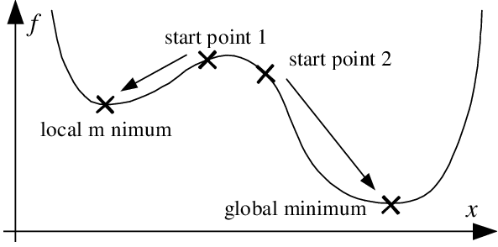
Local and Global Optimum
Notes:
Is global optimum hard to find ?
Do we have time limit?
Is local optimum acceptable ?

Slide 5
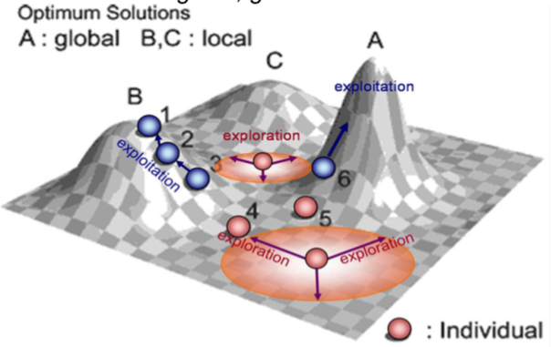
Exploration and Exploitation
Exploitation: Examines neighbors of prerecorded elite solutions
Exploration: Examines unvisited regions, generates different solutions
Notes:
Exploitation:
Based on modifying choice rules to encourage good move combinations
and solution attributes May lead to return to attractive regions

Slide 6
Tabu Search
Tabu list: a tabu list records forbidden moves, which are referred as tabu moves.
Memory: fixed tabu list size can prevent the algorithm from returning the same solution
Neighborhood set: a neighborhood is constructed to identify the adjacent solutions that can be reached from the current solution.
Stopping criteria: the algorithm will stop, when any criteria are matched: maximum iteration times, no feasible neighbors, early stop for no improvement in the latest n steps

Slide 7
Tabu Search Strategies
Forbidding strategy: controls what enters the tabu list
Freeing strategy: controls what exits from the tabu list – aspiration criterion provides exception to tabu restrictions. When a tabu move has a sufficiently attractive evalution where it would result in a solution better than any visited so far, then its tabu classification may be overridden.
Short-term strategy: manages interplay between the forbidding and freeing stratgy to select trial solutions
Notes:
Tabu search is based on introducting flexible memory structures in conjunction with strategic restrictions and aspiration levels as a means for exploiting search spaces.
A dynamic neighborhood search method: once you have a point, it searches around its neighbors
It uses a flexbile memory to restrict the next solution choice to some subset of neighborhood of current solution
Question is: what goes into the tabu list

Slide 8
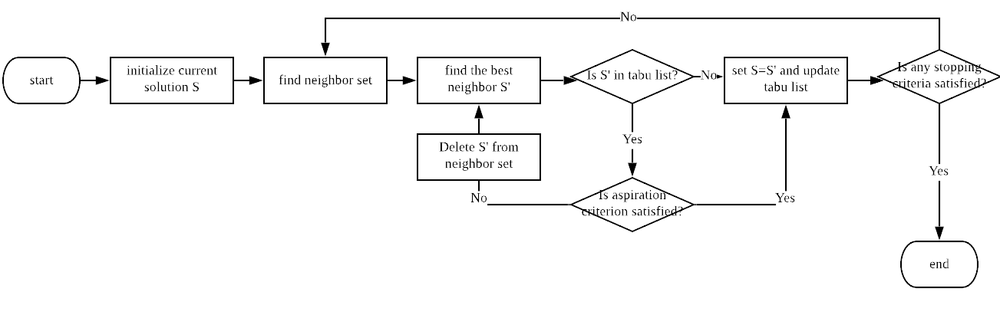
Tabu Search Algorithm

Slide 9
Advantages and Disadvantages
Advantages:
Accepts non-improving solution to escape from a local optimum
Can be applied to both discrete and continuous solution spaces
The result often approximate the global optimum
May be only practical alternative in complex problem
Disadvantages:
Too many parameters
Global optimum is not guaranteed
Different search may yield different result

Slide 10
Example of Tabu Search

Slide 11
TSP problem
5 cities – A, B, C, D, E
Objective: find the minimum distance to travel all cities and return the starting point
Tabu list size = 2
Stopping criteria: iteration times = 5
Aspiration criterion: distance is lower than 1 unit

Slide 12
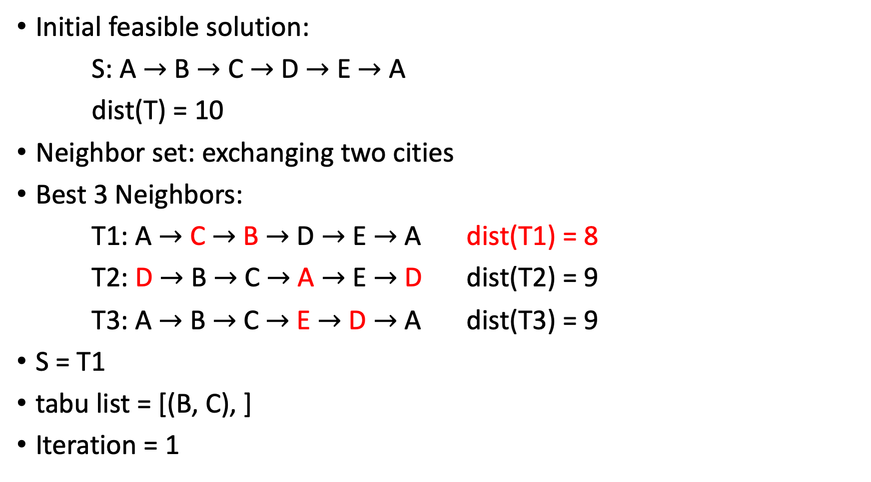
Initial feasible solution:
S: A $→$ B $→$ C $→$ D $→$ E $→$ A
dist(T) = 10
Neighbor set: exchanging two cities
Best 3 Neighbors:
T1: A $→$ C $→$ B $→$ D $→$ E $→$ A dist(T1) = 8
T2: D $→$ B $→$ C $→$ A $→$ E $→$ D dist(T2) = 9
T3: A $→$ B $→$ C $→$ E $→$ D $→$ A dist(T3) = 9
S = T1
tabu list = [(B, C), ]
Iteration = 1

Slide 13
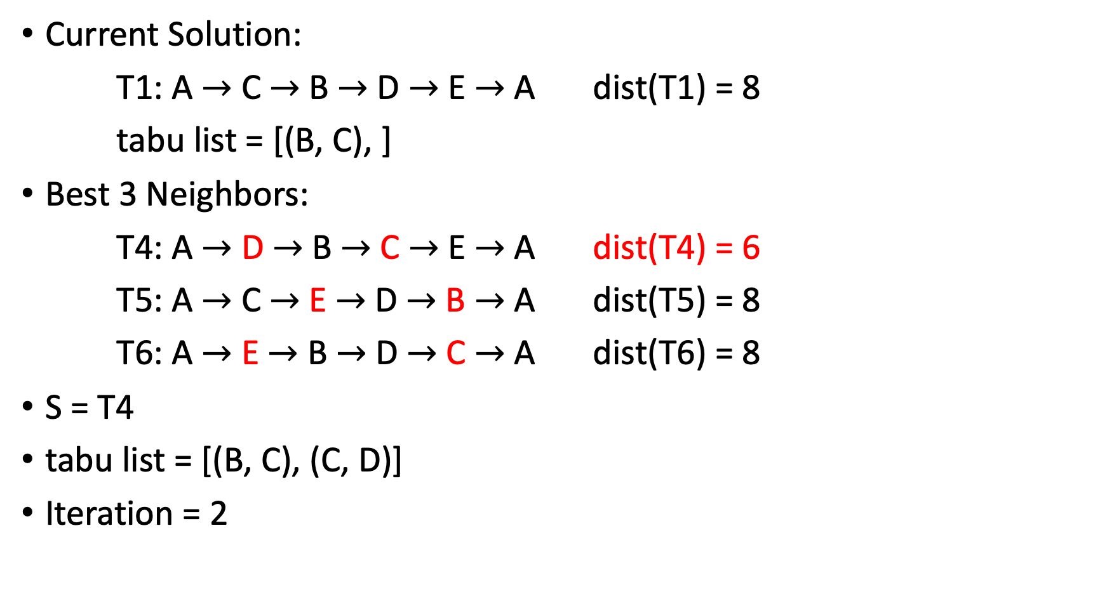
Current Solution:
T1: A $→$ C $→$ B $→$ D $→$ E $→$ A dist(T1) = 8
tabu list = [(B, C), ]
Best 3 Neighbors:
T4: A $→$ D $→$ B $→$ C $→$ E $→$ A dist(T4) = 6
T5: A $→$ C $→$ E $→$ D $→$ B $→$ A dist(T5) = 8
T6: A $→$ E $→$ B $→$ D $→$ C $→$ A dist(T6) = 8
S = T4
tabu list = [(B, C), (C, D)]
Iteration = 2

Slide 14
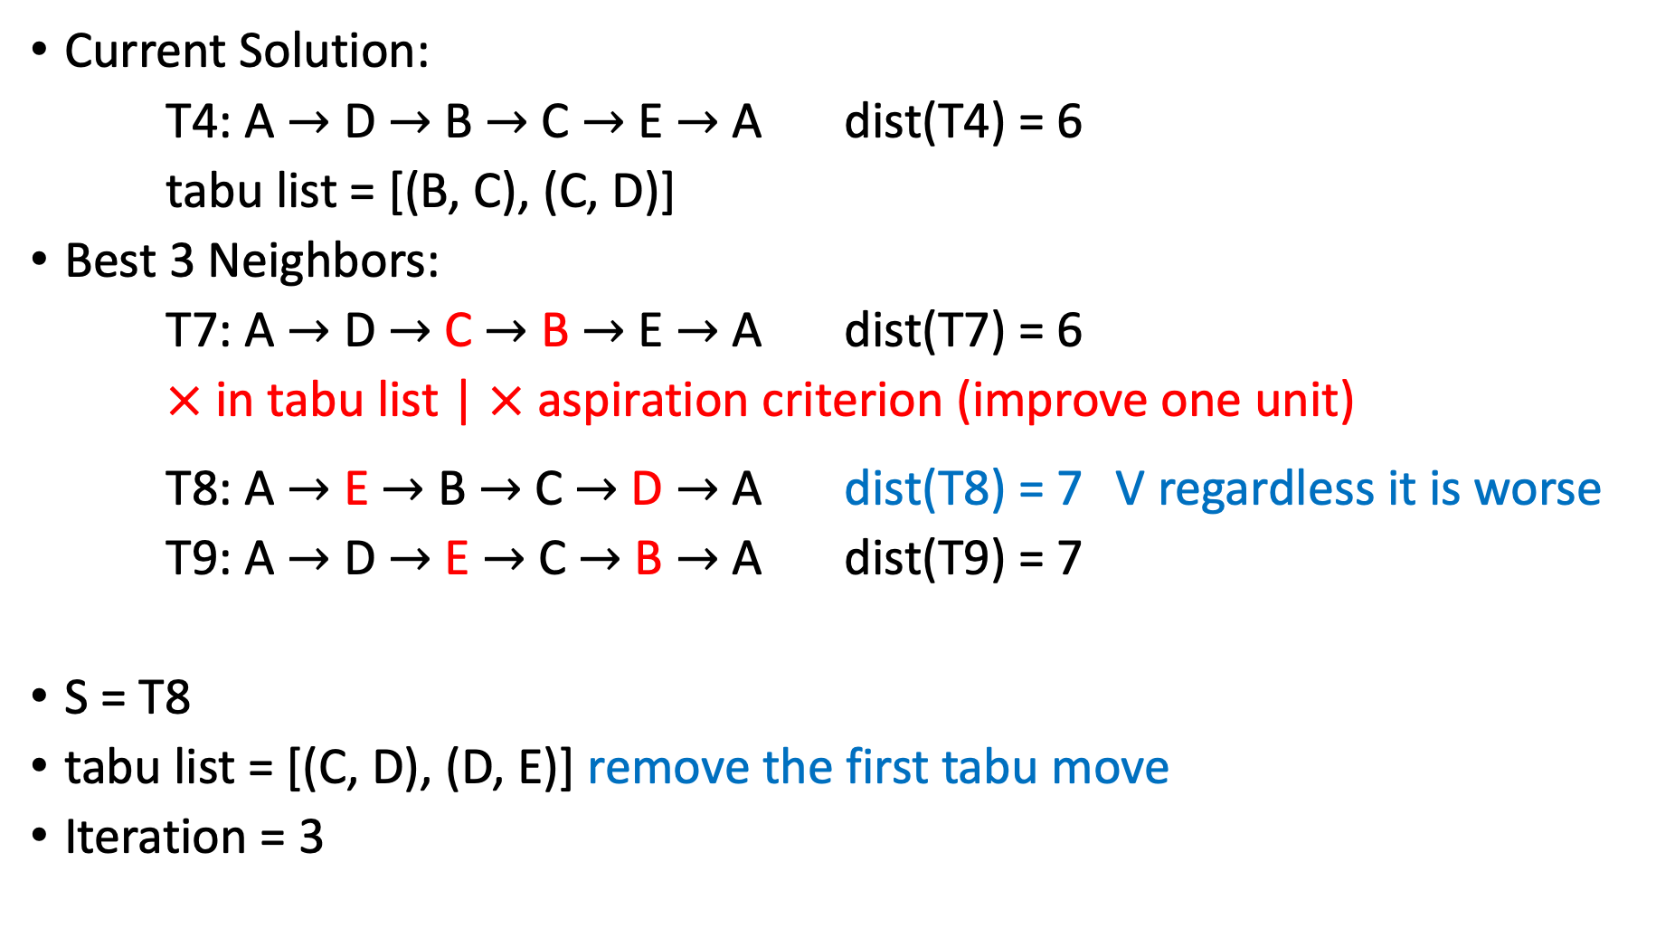
Current Solution:
T4: A $→$ D $→$ B $→$ C $→$ E $→$ A dist(T4) = 6
tabu list = [(B, C), (C, D)]
Best 3 Neighbors:
T7: A $→$ D $→$ C $→$ B $→$ E $→$ A dist(T7) = 6
$×$ in tabu list | $×$ aspiration criterion (improve one unit)
T8: A $→$ E $→$ B $→$ C $→$ D $→$ A dist(T8) = 7 V regardless it is worse
T9: A $→$ D $→$ E $→$ C $→$ B $→$ A dist(T9) = 7
S = T8
tabu list = [(C, D), (D, E)] remove the first tabu move
Iteration = 3

Slide 15
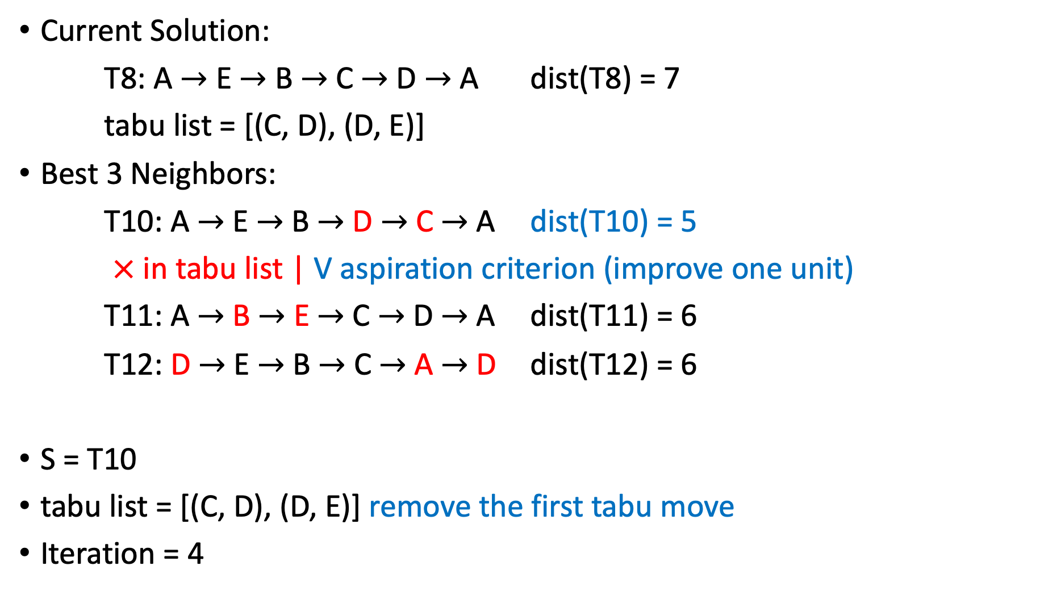
Current Solution:
T8: A $→$ E $→$ B $→$ C $→$ D $→$ A dist(T8) = 7
tabu list = [(C, D), (D, E)]
Best 3 Neighbors:
T10: A $→$ E $→$ B $→$ D $→$ C $→$ A dist(T10) = 5
$×$ in tabu list | V aspiration criterion (improve one unit)
T11: A $→$ B $→$ E $→$ C $→$ D $→$ A dist(T11) = 6
T12: D $→$ E $→$ B $→$ C $→$ A $→$ D dist(T12) = 6
S = T10
tabu list = [(C, D), (D, E)] remove the first tabu move
Iteration = 4

Slide 16
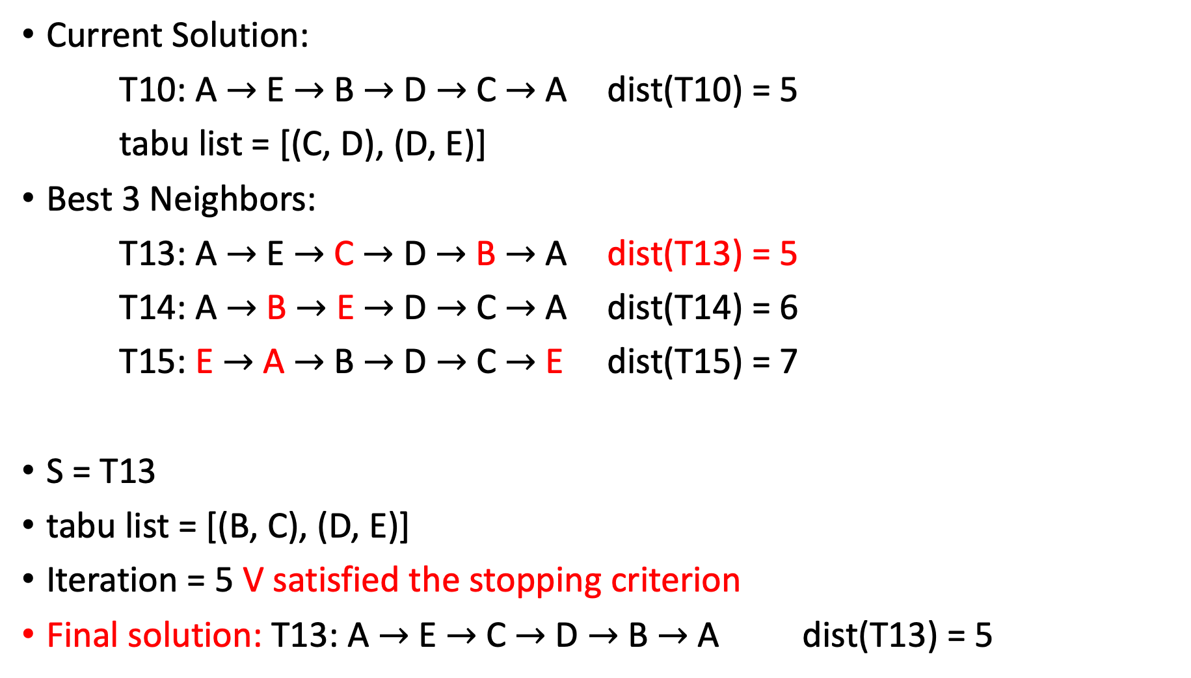
Current Solution:
T10: A $→$ E $→$ B $→$ D $→$ C $→$ A dist(T10) = 5
tabu list = [(C, D), (D, E)]
Best 3 Neighbors:
T13: A $→$ E $→$ C $→$ D $→$ B $→$ A dist(T13) = 5
T14: A $→$ B $→$ E $→$ D $→$ C $→$ A dist(T14) = 6
T15: E $→$ A $→$ B $→$ D $→$ C $→$ E dist(T15) = 7
S = T13
tabu list = [(B, C), (D, E)]
Iteration = 5 V satisfied the stopping criterion
Final solution: T13: A $→$ E $→$ C $→$ D $→$ B $→$ A dist(T13) = 5

Slide 17
Portfolio Optimization

Slide 18
Portfolio Restrictions
Objective: form a portfolio that maximum the historical return
Constraints:
Should at least select 10 and at most 30 stocks
The number of stocks from the same sector cannot exceed 6
The average correlation of selected stocks cannot exceed 0.5
Average VaR cannot lower than -0.03
Individual stock VaR cannot lower than -0.05
Notes:
Value at risk: Value at risk (VaR) is a measure of the risk of loss for investments. It estimates how much a set of investments might lose (with a given probability), given normal market conditions, in a set time period such as a day. The smaller the VaR means the stocks is more risky

Slide 19
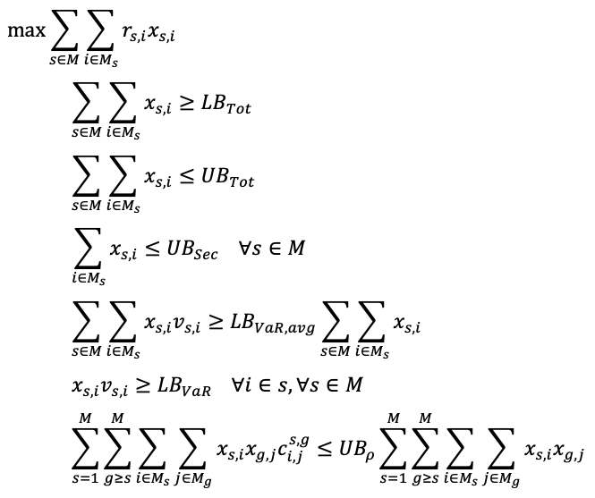
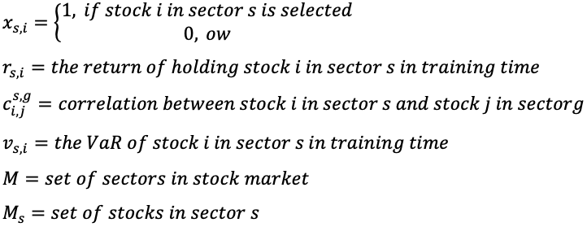
Linear Programming Formulation

Slide 20
Dataset
Stocks List: S&P 500 component stocks
Training period: 2016-01-01~2019-12-31
Testing period: 2020-01-01~2020-04-17
(the huge drop is on 2020-02-21)
has trend: 2020-01-01~2020-02-19
no trend: 2020-02-19~2020-04-17

Slide 21
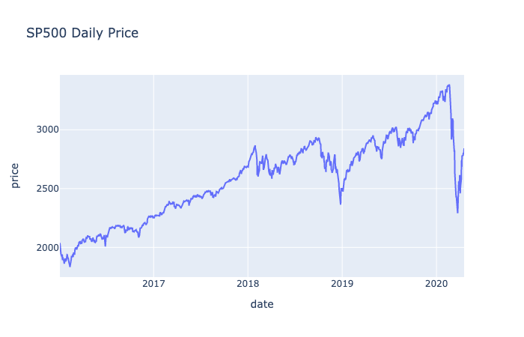

Slide 22
Experiment Results

Slide 24
Tabu Search Parameters
Using grid Search to find the appropriate parameters for this problem
Tabu list size | 10 | 30 | 50
Max iterations | 100 | 200 | 300
Early Stop | 20 | 50 | Inf
Aspiration Level | -1 | 1 | 5
Neighbor Size | 50 | 100 | 300
*note: using neighbor size as the sample size in neighbor hoods

Slide 25
 | count | mean | std | min | 25% | 50% | 75% | max | SP500
train_perf | 243.0 | 0.9290 | 0.0732 | 0.8432 | 0.8432 | 0.9222 | 1.0217 | 1.0217 | 0.5774
whole_period_perf | 243.0 | -0.1241 | 0.0146 | -0.1388 | -0.1388 | -0.1291 | -0.1042 | -0.1042 | -0.1239
normal_period_perf | 243.0 | 0.0415 | 0.0065 | 0.0323 | 0.0323 | 0.0459 | 0.0463 | 0.0463 | 0.0418
extreme_period_perf | 243.0 | -0.1588 | 0.0192 | -0.1769 | -0.1769 | -0.1674 | -0.1323 | -0.1323 | -0.1591
cand_test_perf | 243.0 | -0.0792 | 0.0145 | -0.0959 | -0.0959 | -0.0813 | -0.0605 | -0.0605
used_time | 243.0 | 169.7392 | 151.6012 | 30.3094 | 64.5552 | 112.8851 | 225.8990 | 818.1573
iteration | 243.0 | 113.8889 | 79.0177 | 43.0000 | 63.0000 | 90.0000 | 101.0000 | 301.0000

Slide 26
Gurobi: cannot find (global) optimal value after running almost 3 days

Slide 27
Conclusions
Tabu search is more practical on complex optimization problem

Slide 28
Reference
Picture:
local and global optimum: https://www.researchgate.net/figure/Local-versus-global-optimum_fig1_228563694
Tabu search flow chart: https://www.researchgate.net/figure/Flowchart-of-tabu-search-algorithm_fig1_320508257
Paper:
Portfolio optimization models and a tabu search algorithm for the Kuwait Stock Exchange: https://www.researchgate.net/publication/286938758_Portfolio_optimization_models_and_a_tabu_search_algorithm_for_the_Kuwait_Stock_Exchange

